Slide 1
Comprehensive Review and Implementation of Novel Amplification Factors in Low-Light Denoising
Maximilian Drach

Slide 2
Deep Dive Review and Testing
Learning to See in the Dark U-Net Pipeline
Restoring Extremely Dark Images in Real Time Preamplification Factor
Notes:
I will reimplementing the U-Net Pipeline
And implement the Preamplifiaciton factor from _

Slide 3
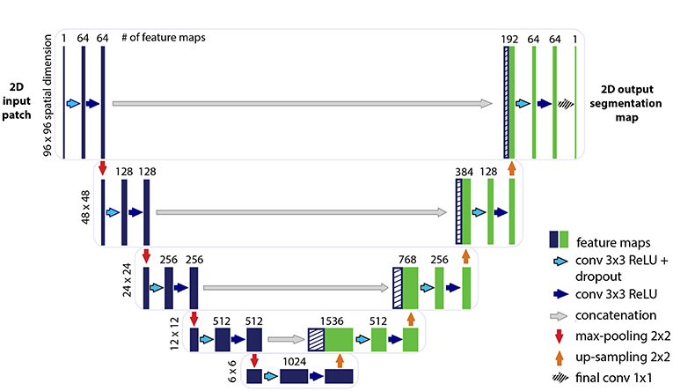
How well does the U-Net Pipeline transfer to other Camera Models?
Sony Alpha 7 II
Canon EOS 850D & Nikon D600
Notes:
The U-net is trained on the Sony Alpha 7 II camera, this is a great low-light camera and one of the best you can buy on the mark
The cameras I used are not top of the line low-light cameras and are most would consider lower hardware
Sine the u-net is trained on one specific cameria, I want to see it performance as we try to use its denoising and image enhancing pipline on other hardware

Slide 4
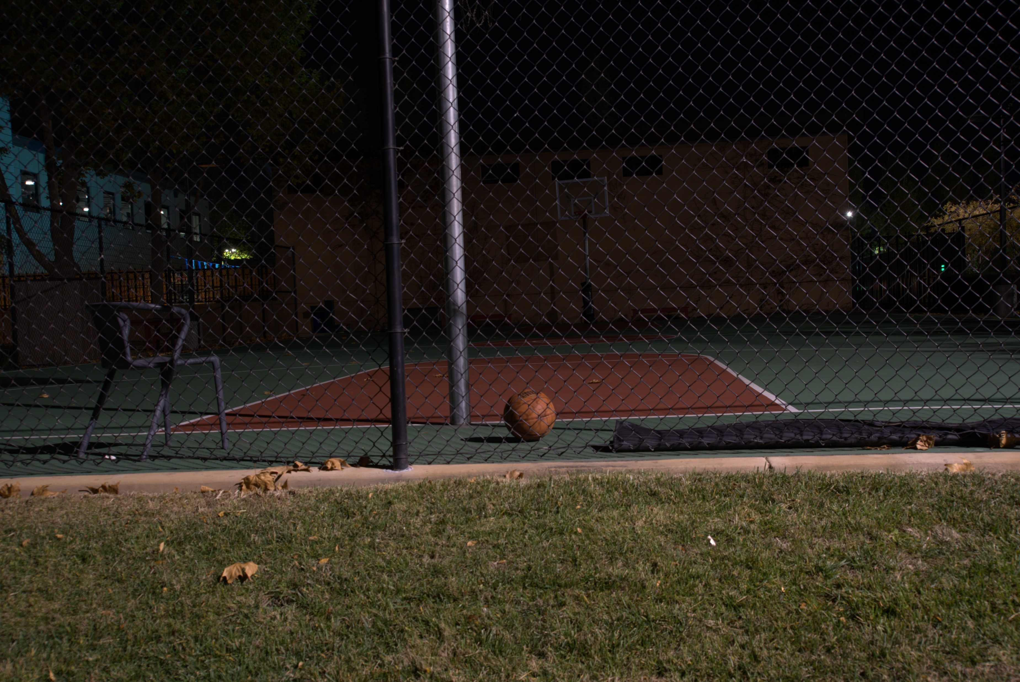
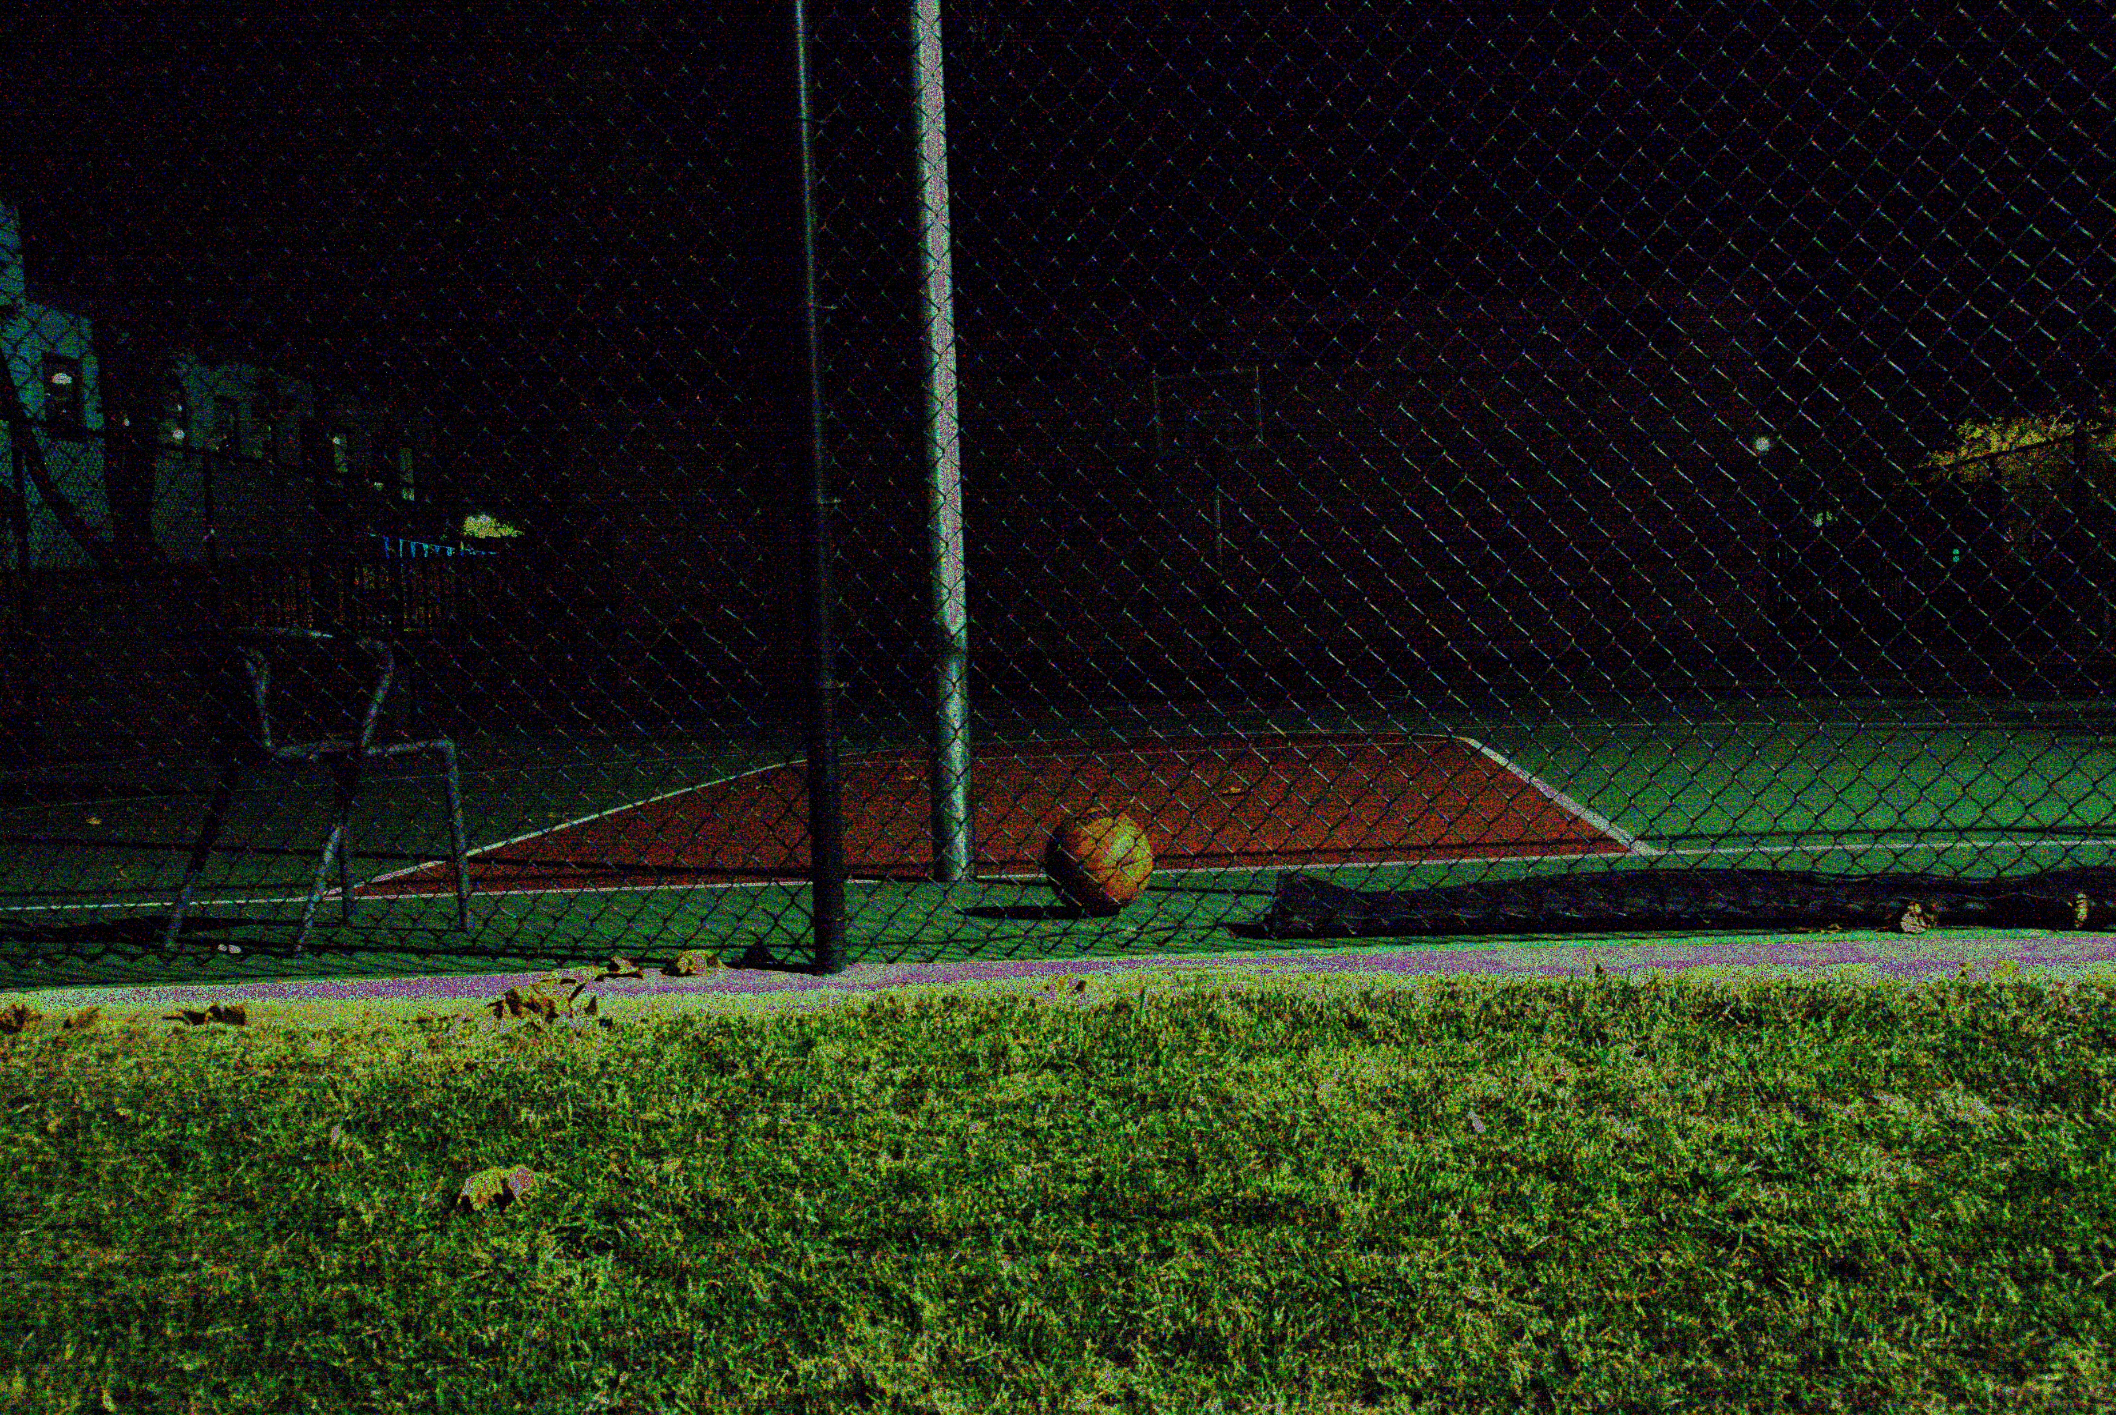
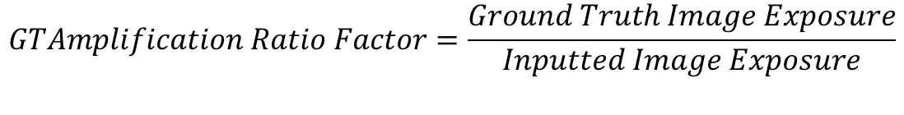
How to determine the Ground-Truth Image Exposure?
$$GTAmplification Ratio Factor=\frac{Ground Truth Image Exposure}{Inputted Image Exposure}$$
Ground Truth Image
Inputted Image
Notes:
This is crucial issue with the learning to se in the dark paper and other papers
They use the ground truth amp ratio as the pre-amplificatication of the image before running it toruhg the u-net pipline
This is critical because in the real world secenarios, you are not going to know what the ground truth exposure,
Finding alternaitves to this is critical, otherwise the piplines are useless in the real world

Slide 5
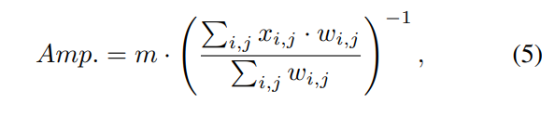
How effective is the Lamba Amp Factor?
Inputted Image
Notes:
Restoring Extremely Dark Images in Real Time _> DR Lamba & Mitra propose a novel amp factor that does rely on ground truth
It uses a gamma correction like enhancement that exponentiatlly increase the amplification for dimmer pixels and inversely exponninly decrese for brighter pixels
I want to test how effective this pre-amp factor is, because it could have real world use cases and allow these piplines to be actually implimented

Slide 6
What are the performance comparisons?
Lamba Amplification Factor vs Ground-Truth Amplification Factor
Sony Alpha 7 II vs Canon EOS 850D vs Nikon D600

Slide 7
Creating my Dataset
Canon EOS 850D -> Wider Shutter Speed Range
Collected 15 different scenes
Wide Range of Shutter Speed Values
Test High Shutter Speeds
Nikon D600 -> Granular ISO Range
Collected 2 different scenes
+1 test scene at ISO 100
ISO (100 – 6400)
Wide Range of Shutter Speed Values
Test ISO Impact

Slide 8
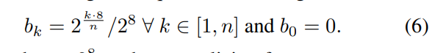
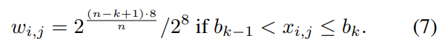
Implementing Lamba Amp Factor
Notes:
So there are a range of bins created -> these bins store the different weights associated with the differente pixels
Custom weights are assigned to each pixel
Allocate finer bin,for more exact values in lower intensity
Wider bins for high light intensity ie more
Created the wegihts on log scale, for greater amplification on dimmer pixel and less on brighter ampli
M is amplification hyper parameter

Slide 9
Testing Metrics PSNR & SSIM
Peak Signal to Noise Ratio (PSNR)
Higher PSNR -> Smaller Difference between Original & Reconstructed Image
Based on MSE
Global Pixel-wise difference
Log-scale in terms of (dB)
Structural Simlarity Index (SSIM)
Localized pixel-wise difference
Accounts for luminance, contrast, and structure
More aligned with human perception
Range from [-1,1]
Notes:
Focus: PSNR primarily measures the global pixel-wise difference between the original and reconstructed images.
Base
SIM index is calculated by comparing local patterns of pixel intensities, luminance, contrast, and structure between the reference (original) image and the distorted (reconstructed) image.
SSIM index takes into account luminance, contrast, and structure.
Higher is better
the index ranges from -1 to 1, where 1 indicates perfect similarity, 0 indicates no similarity, and -1 indicates complete dissimilarity.

Slide 10
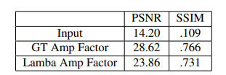
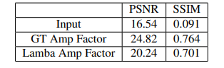


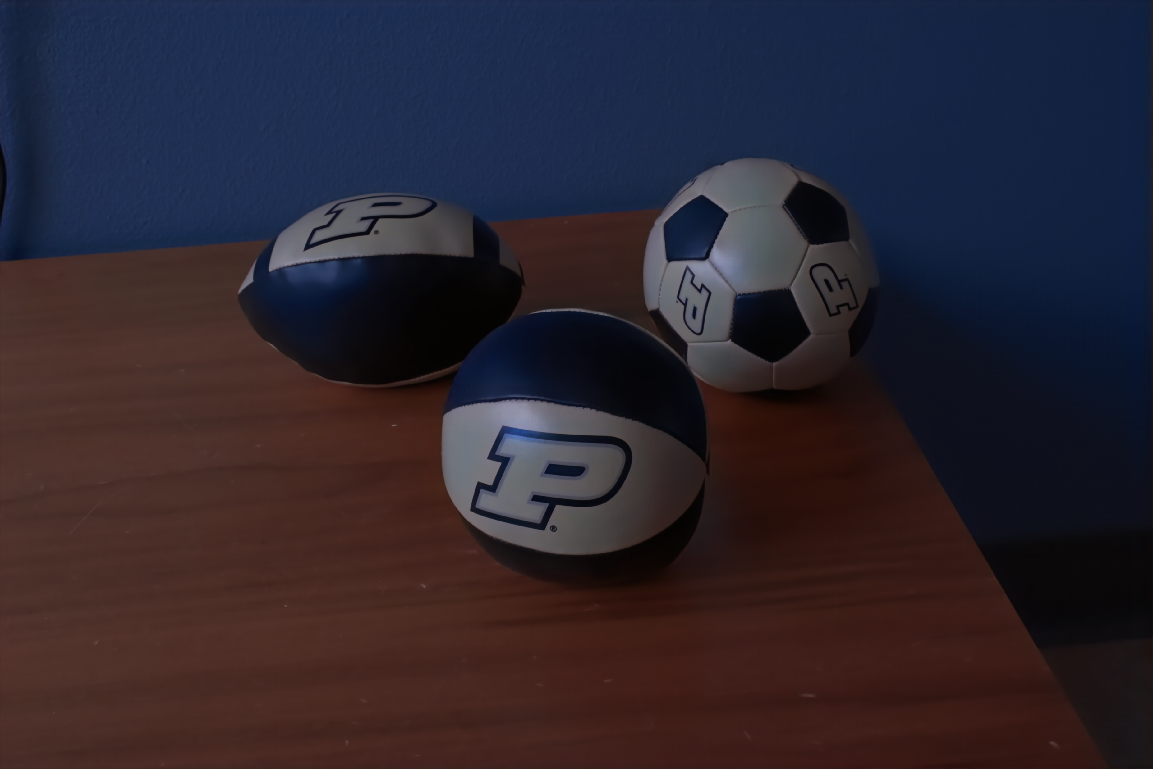
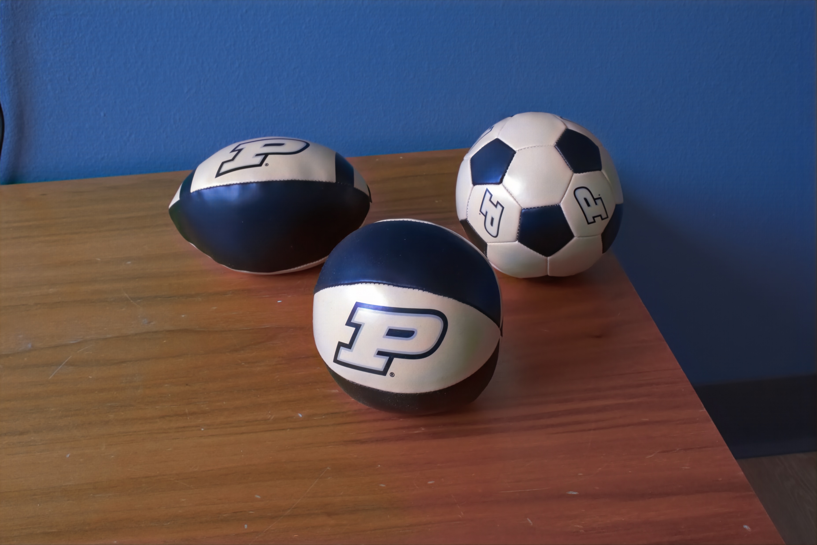
Lamba Amp alternative to GT Amp?
Sony SID Dataset Test Average PSNR & SSIM Result
Canon GT-Ratio ≤ 300 Adjusted Test Average PSNR & SSIM Result
Really Good Usually
Slight overexposure in slower shutter speeds
Notes:
The lamba amp had surpirusing great performance on both the canon and sid dataset
it works extremely well in the lower lighting and only slightly causes over exposure in the the brighter settings

Slide 11
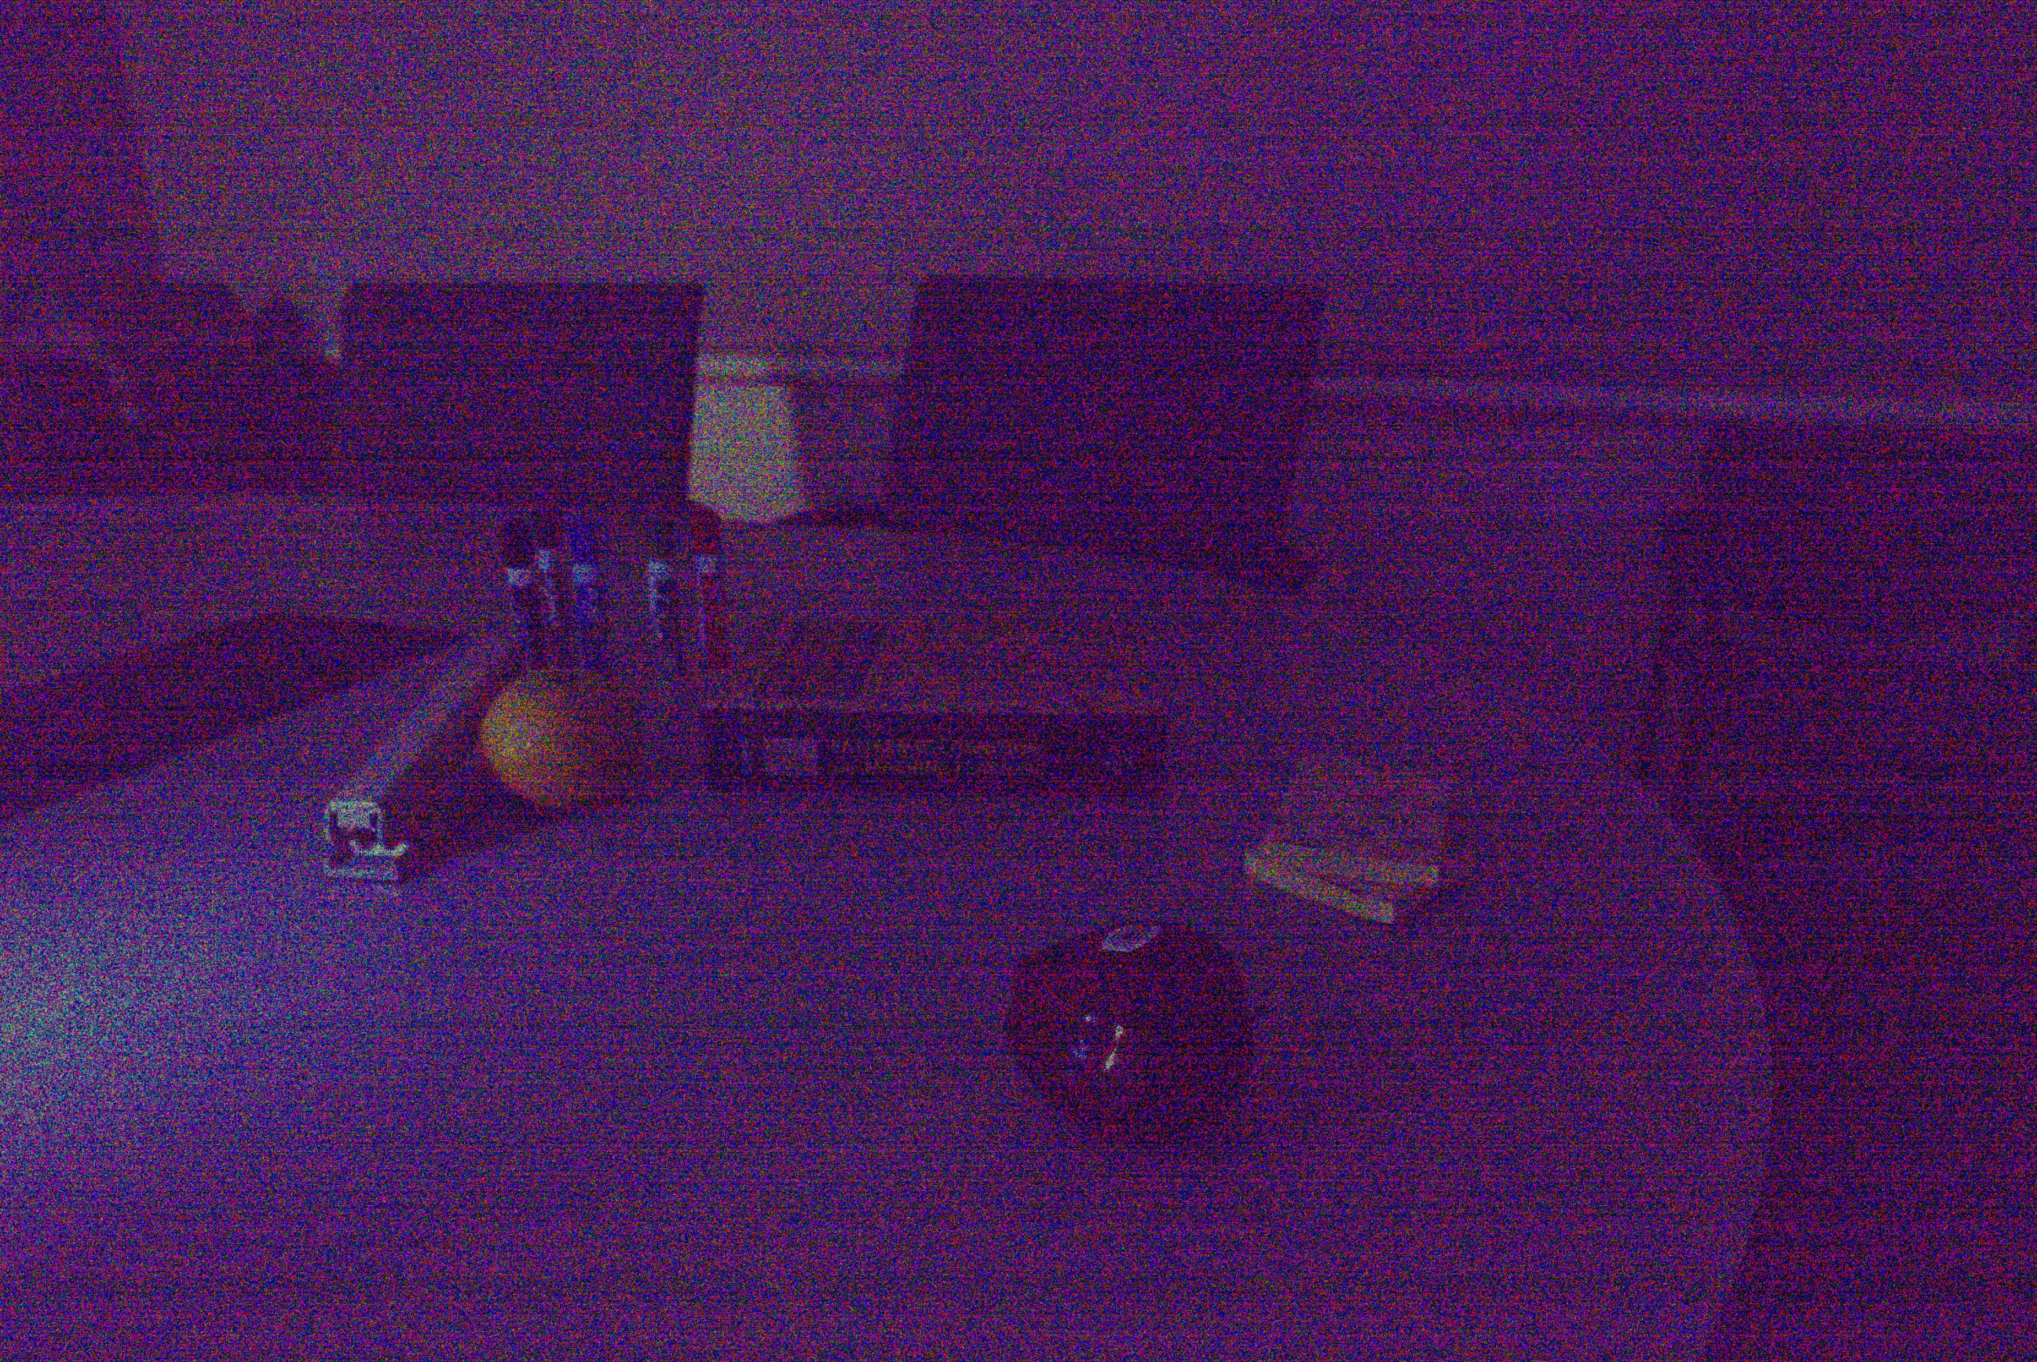

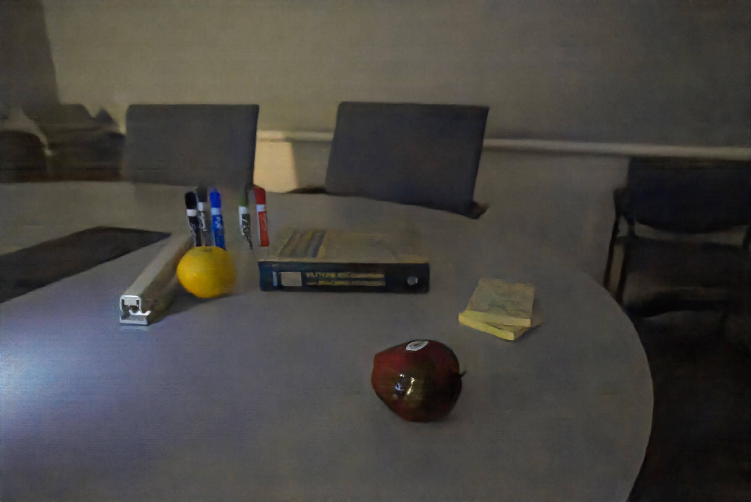
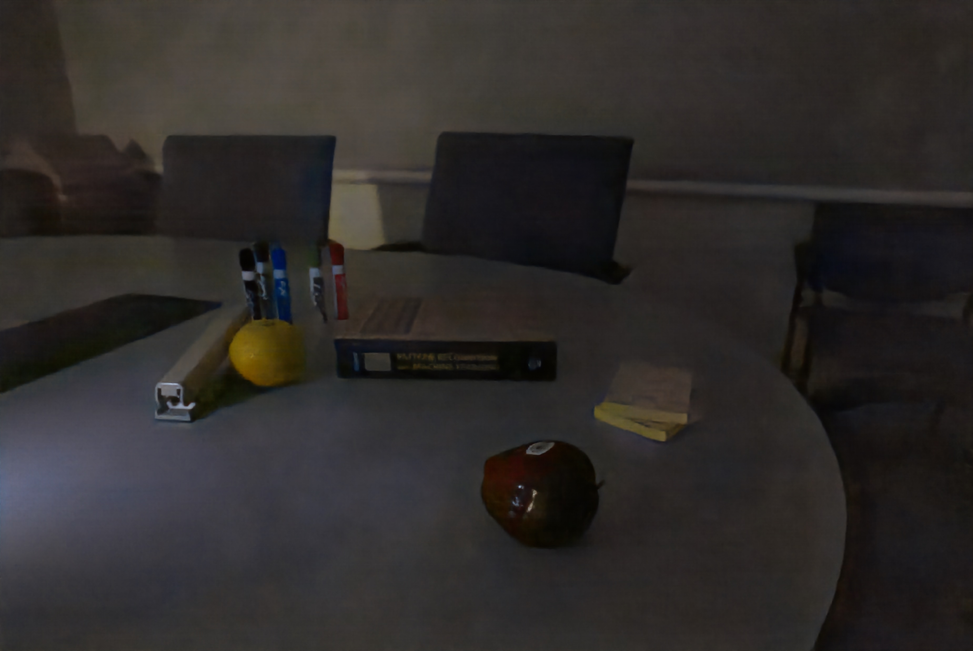
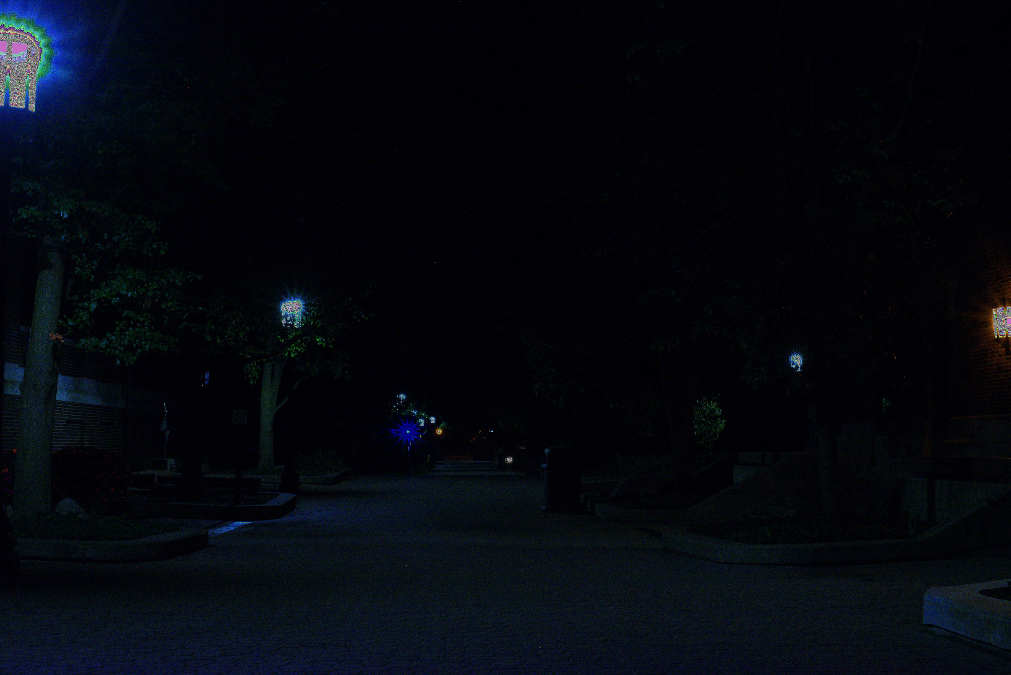
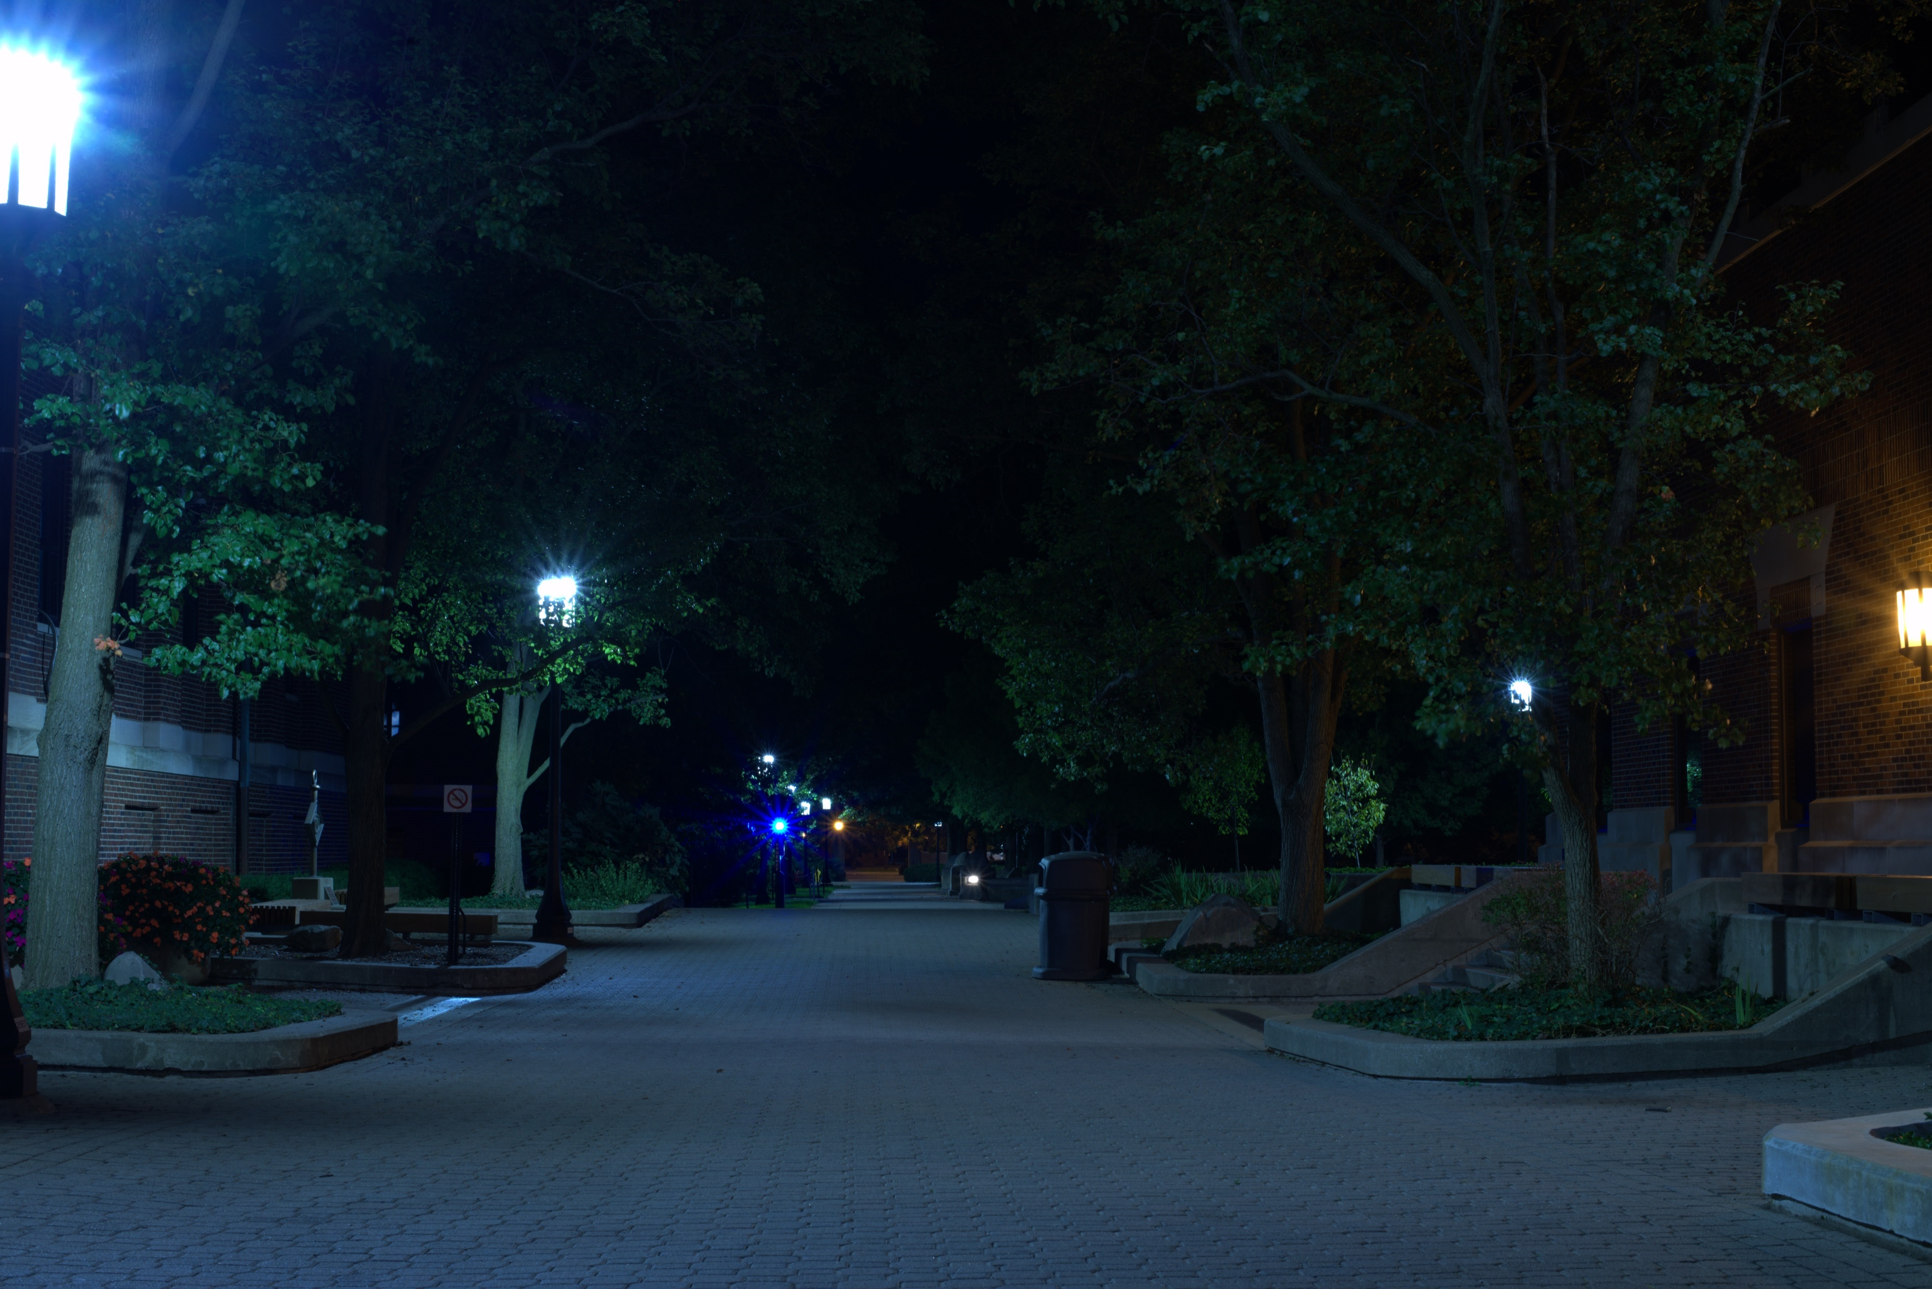
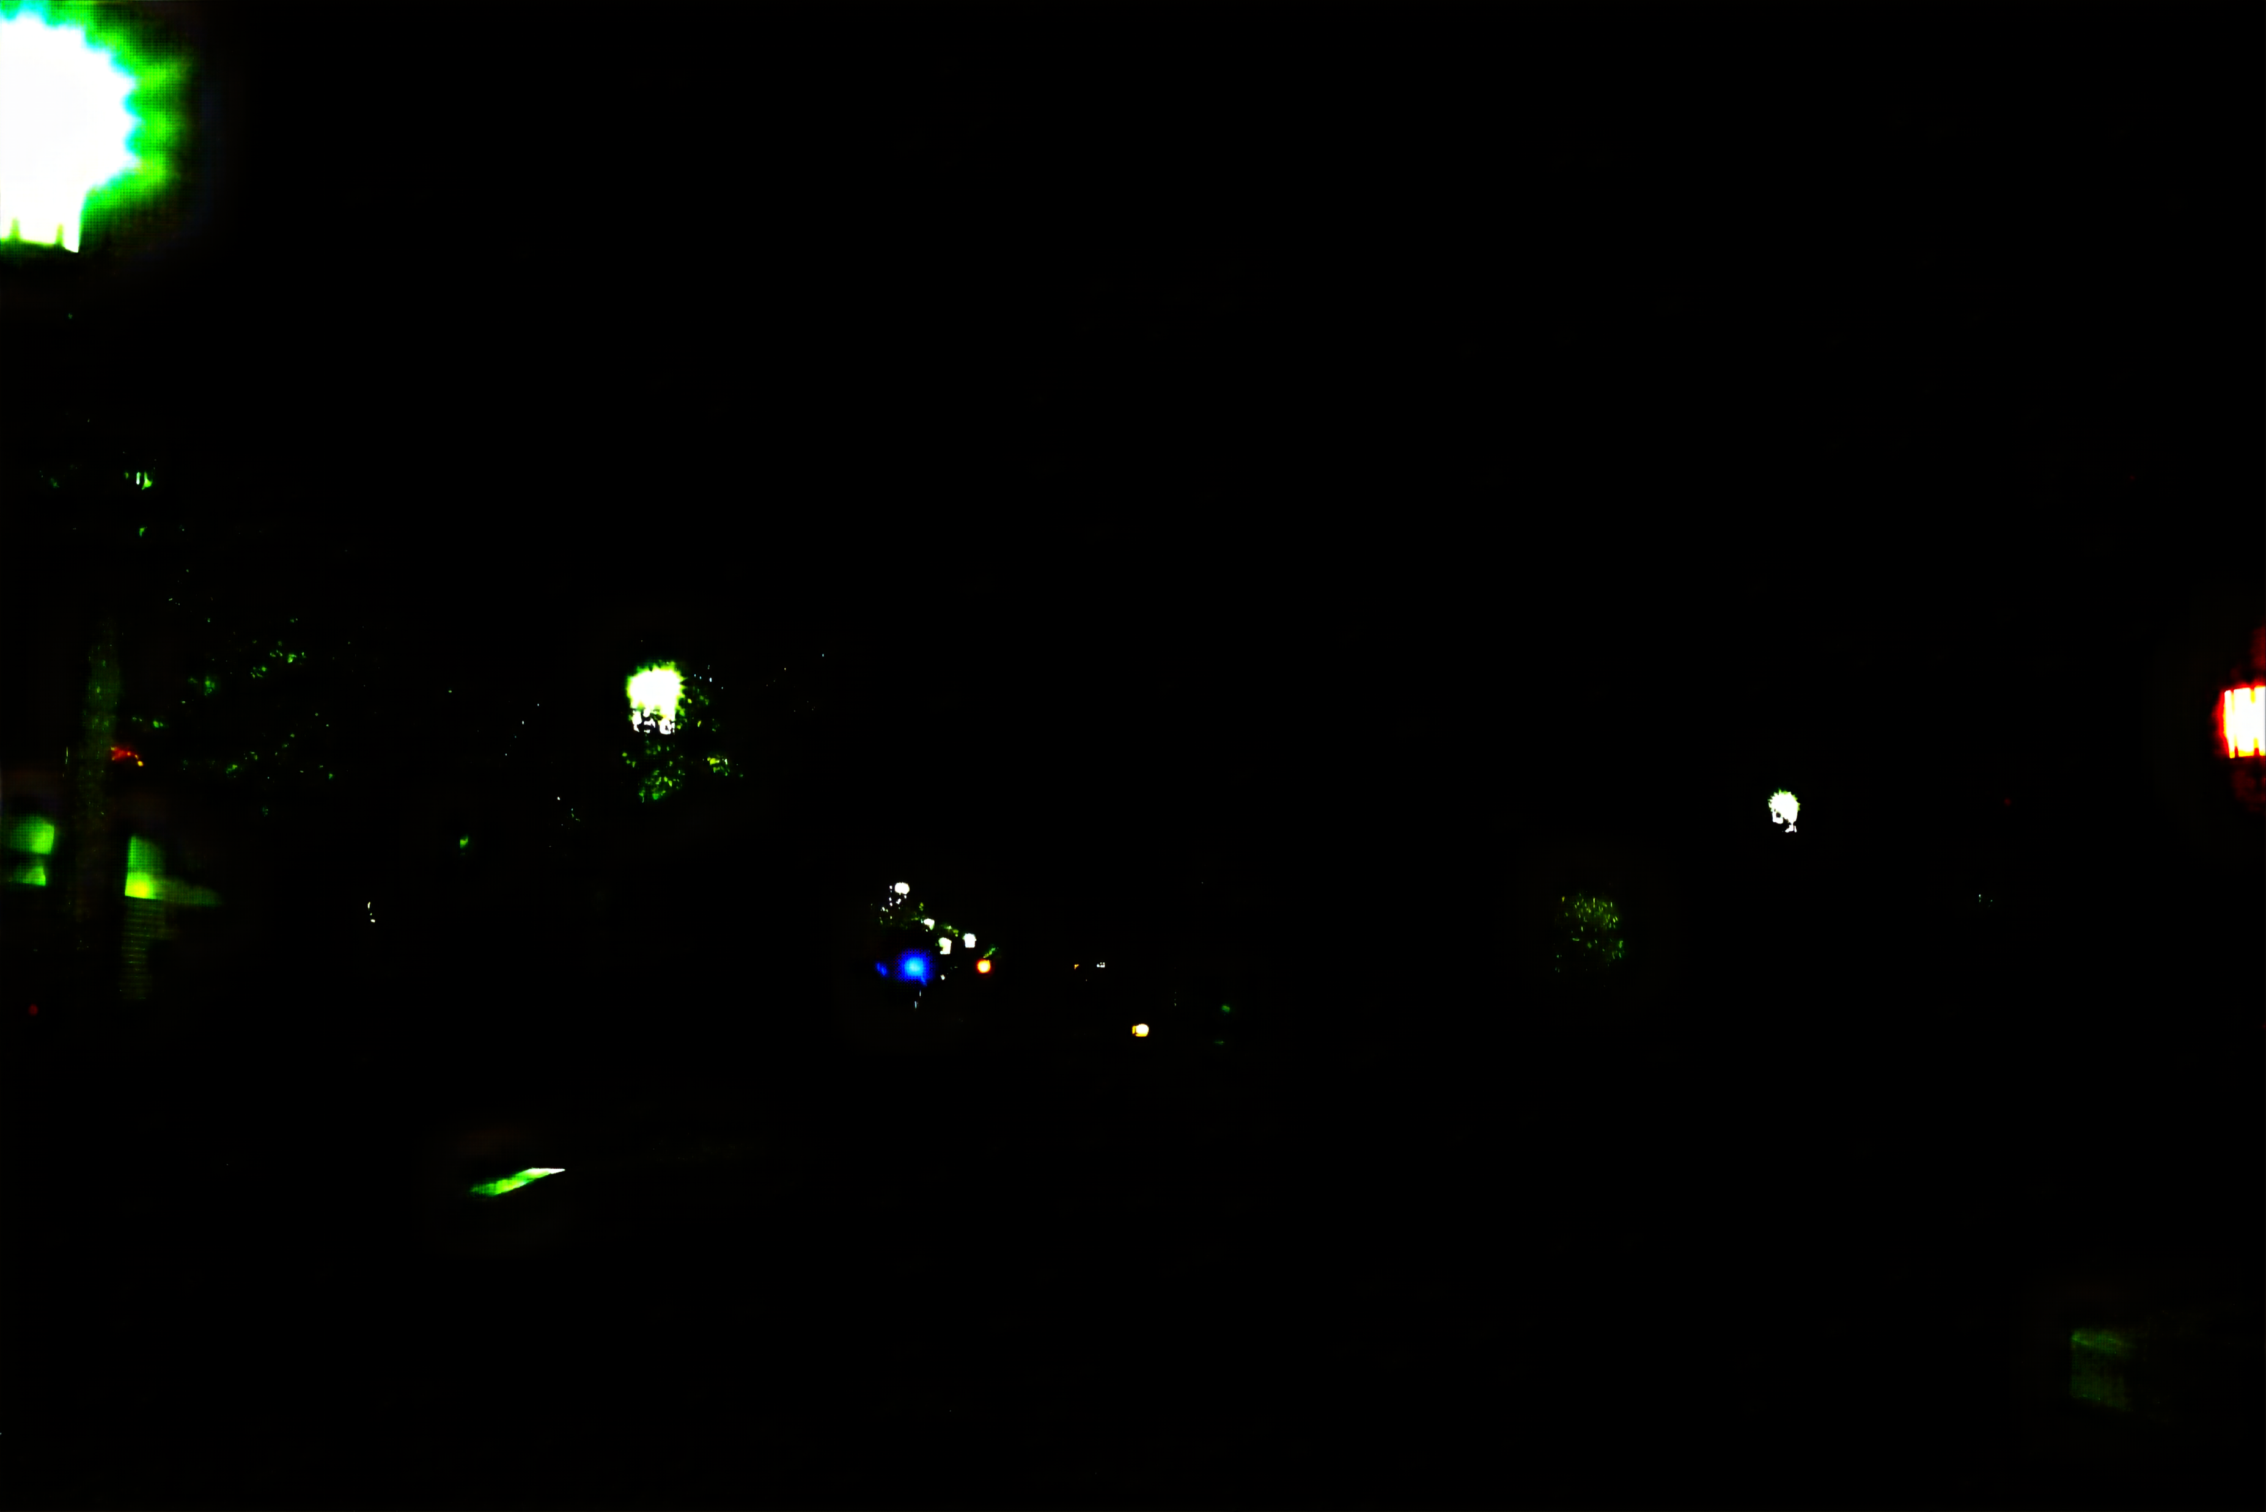
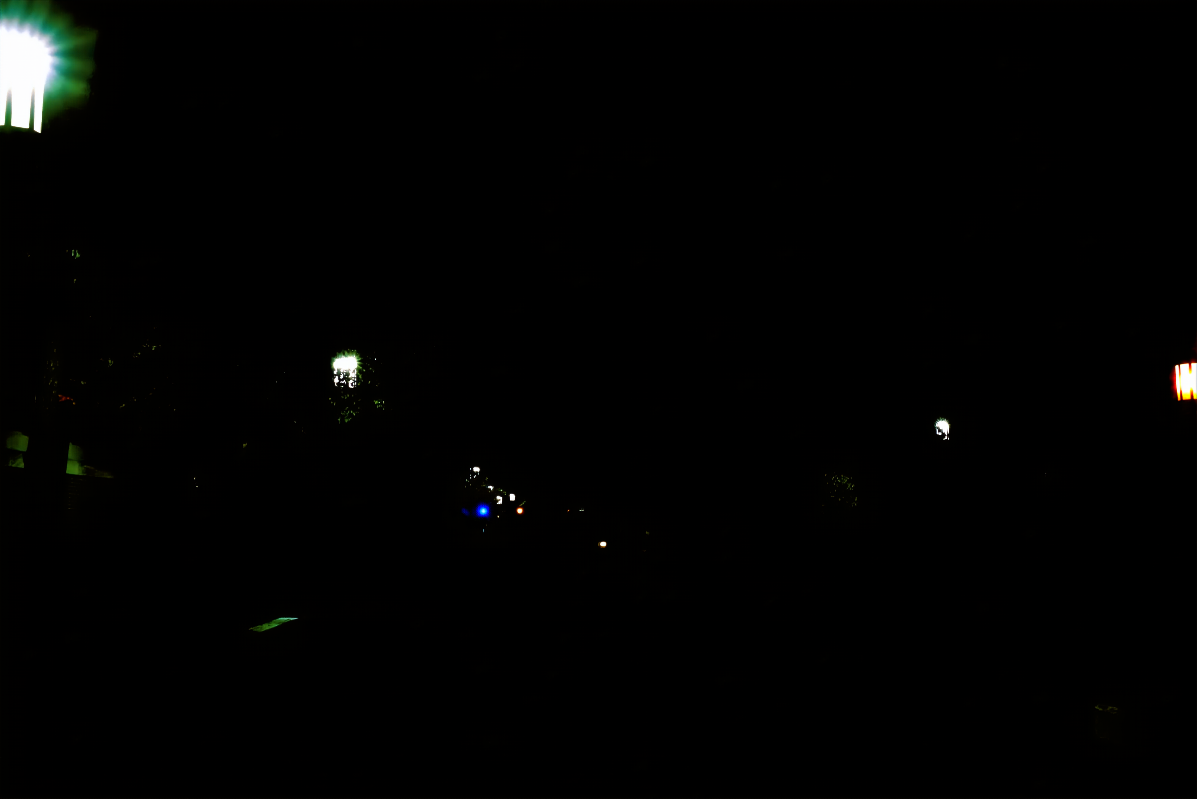



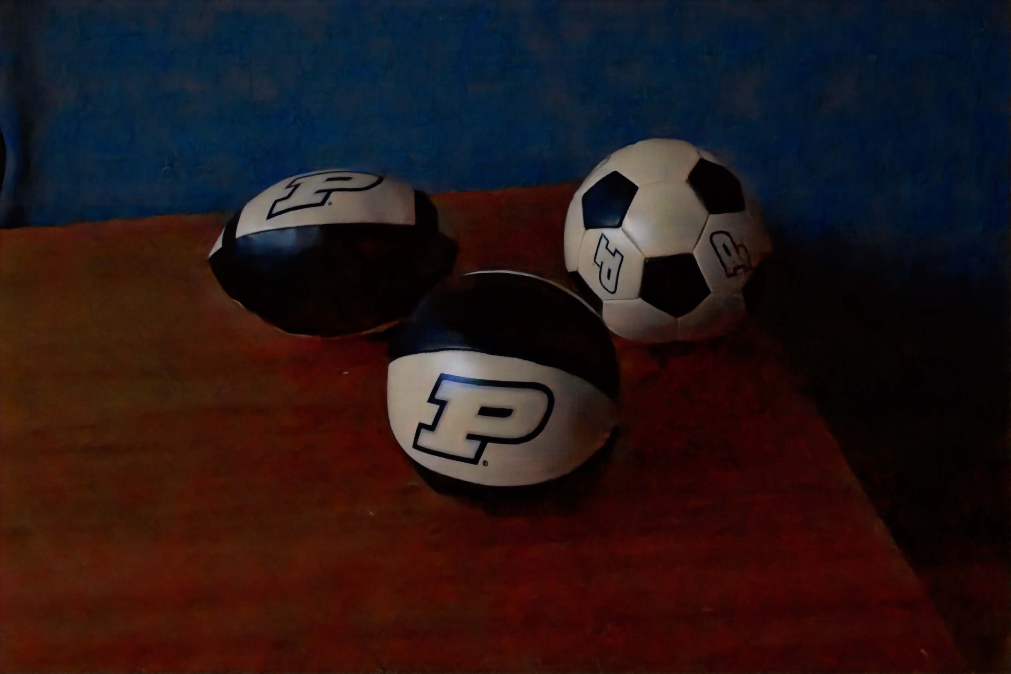
Pipeline Generalizability?
Input
GT
GT-Amp
Lamba Amp
Sony
GT-Ratio 300
ISO 100
Nikon
GT-Ratio 299
ISO 100
Canon
GT-Ratio 300
ISO 200
Notes:
These seems to be some issues in the piplines gernaliblity
While its permorance was lower in the canon dataset _> this was prob due to the internal noise difference in the camer
Other future paper have come out with calibration methods to try and avoid this issue and make the unet pipline more general
There was almost no perfamcen gain in the Nikon dataset, even when accounting for the same ISO we still saw lower performance

Slide 12
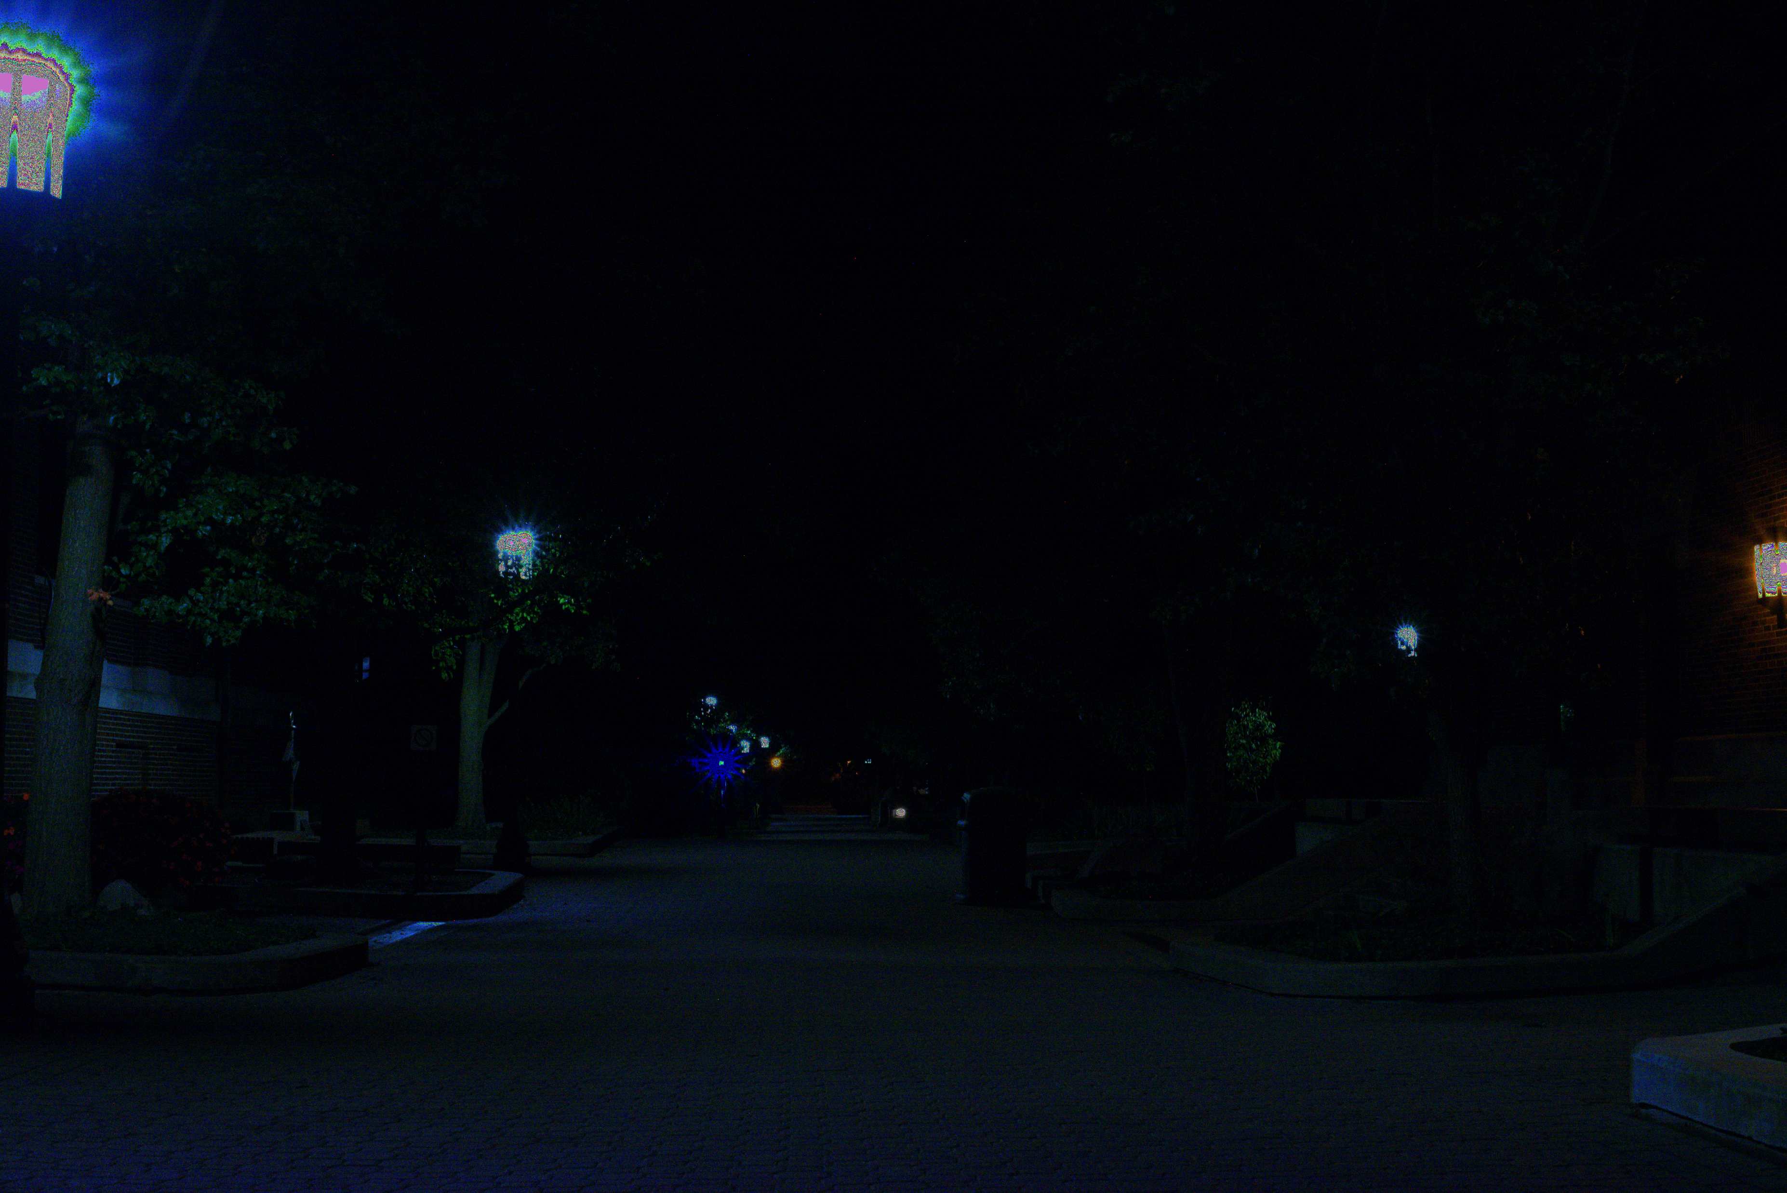

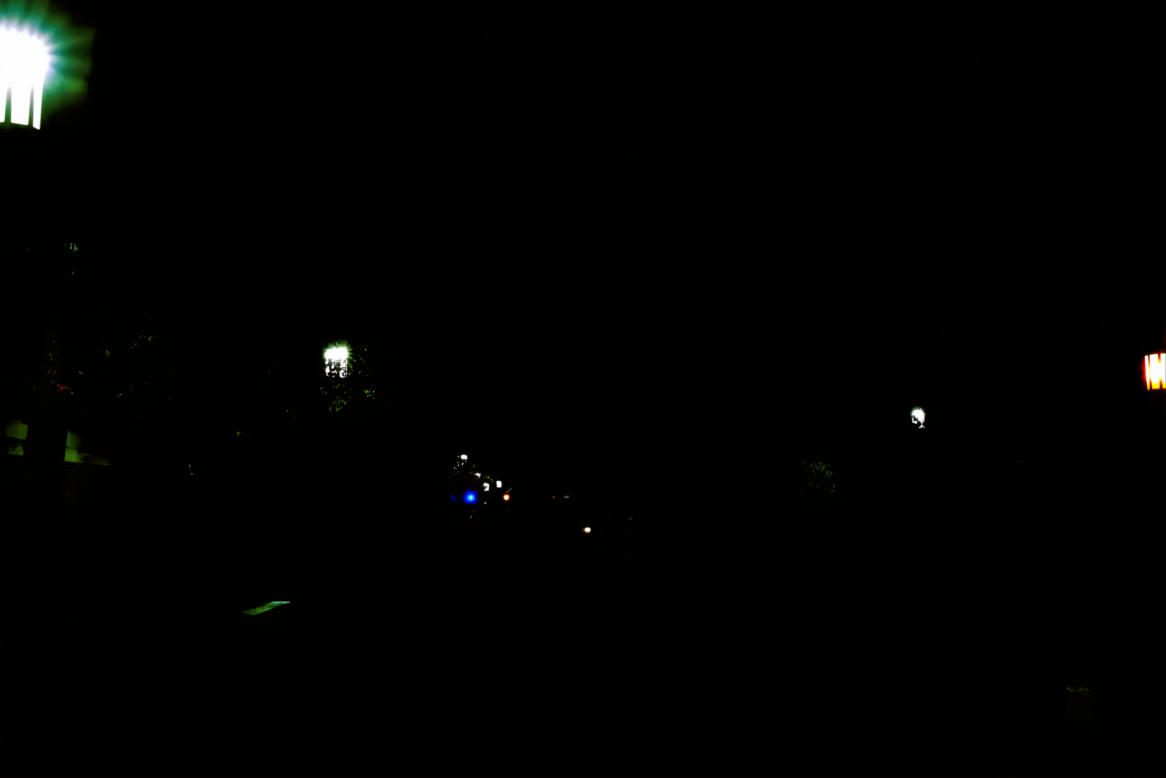

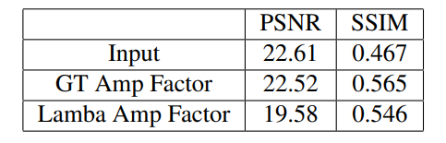
Nikon Poor Results?
Nikon:
Different Black Channel Level!
Same Bayer Array & White Channel Levels?
ISO 100
GT-Ratio 300
input
GT
GT-Amp
Lamba-Amp
Nikon GT-Ratio ≤ 300 Adjusted Test Average PSNR & SSIM Result
Notes:
NIKON had a different black channel level !
Even when accounting for those difference in the code, it still had poor performance. I am not sure about the reasons why.
Even when accounting for the GT ratio and the ISO it still had poor performance and it is unknown why
After review the code, the they had the same bayer array and all the other features seemed to be the same, I am unsure why this had specific subpar preformance

Slide 13
Take-Home Messages
Lamba Amplification had great results! -> Could be a practical alternative to GT Amplification
Pipeline has lower performance on different cameras
Lower performance in Canon Dataset
No disgustable performance in Nikon Dataset
Further Investigation into Nikon poor performance is needed

Slide 14

Questions?

